Slide 1
Sample Mid-term Project: Gaming club
Description: Project that allows to user play games (track delivery and guess game).
Abdurasulov Mirsaid , 12225253
https://youtu.be/oXQDaq2yGow

Slide 2
Content
Planning
Evaluation
Check if the user requirements are met
Demo video [not presented, but for reference]
Functionality Test
Check if the program works without crashing for the given requirements
High level explanation of the Code
Elements used

Slide 3
Planning: Problem
Task
Track delivery game allows user to order variety of fast and delicious food and check the status of delivery whether delivery shipped or not. In guess game, there is secret number that user should find it.
Problem
Doing it on paper, or on head is time consuming.
Goal
We would like to optimize the process with the help of computers and programs.

Slide 4
Planning: User requirements
A program shows two games to choose
Track delivery
1 User can choose what to be shipped for him.
2 User can check status of the thing he shipped. For example, computer may say shipped or on the way it, depending on how many times you press status command
3 And he can also cancel his order. Game continues until user quitted.
Guess game
User should find the secret number in this game. There is a three chance for him to find and no one knows the secret number even programmer because computer generates it randomly.

Slide 5
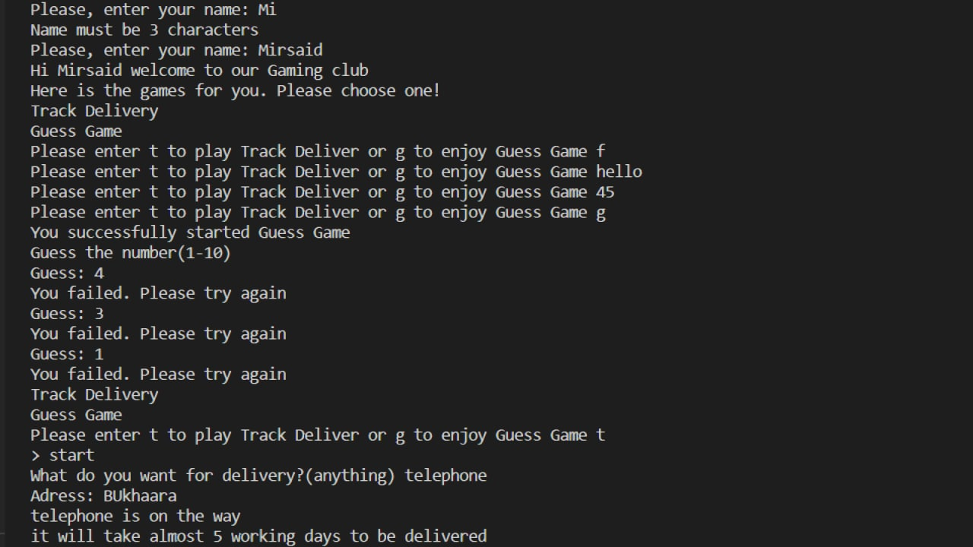
Evaluation: User requirement 1
Program should keep working in the loop (withoout stopping)
Intro
1 User must enter his name
If user”s name is 3 characters or more than 50 characters. Programm will never continue it will ask for name untill name looks good
b Selection
1 Two games to choose user should press “t” to start delivery game g to start guess game no other integers and strings accepted.
Rnd 1
Round 2
Round 3

Slide 6
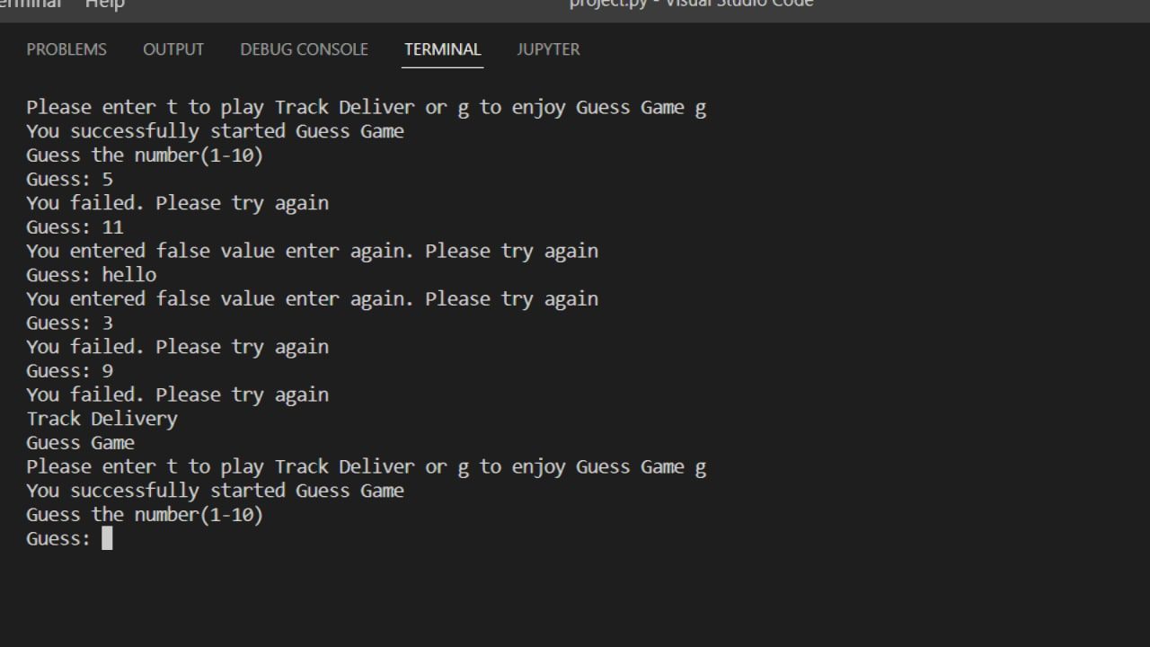
Evaluation: User requirement 2 (Guess Game)
Program should randomize secret number for user to find:
1 You cannot enter string or interger(other than numbers from 0 to 10)
2 User has three chances to find the secret if user cannot find the number program automatically returns to the main menu

Slide 7
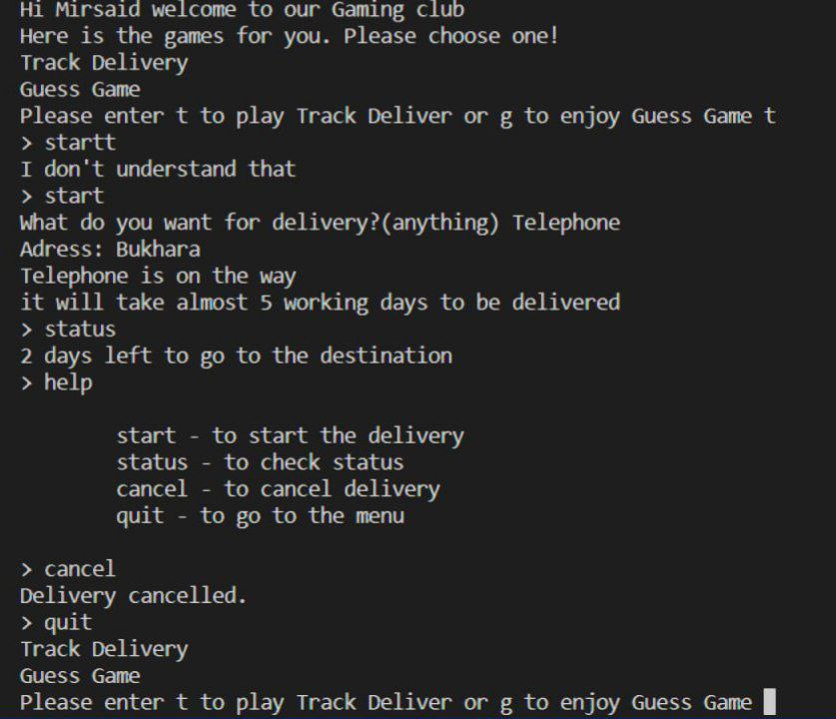
Evaluation: User requirement (Track Delivery)
Track Delivery
1 User can choose what to be shipped for him.
2 User can check status of the thing he shipped. For example, computer may say shipped or on the way it, depending on how many times you press status command
3 And he can also cancel his order. Game continues until user quitted

Slide 8
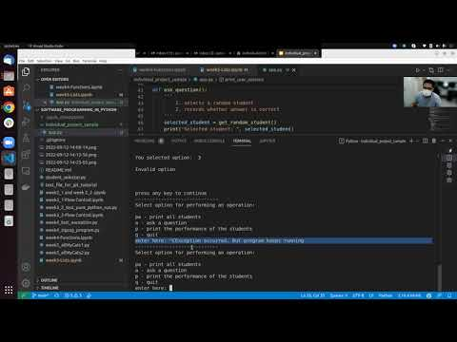
Demo for functionality test and high level code explanation [not presented, for reference]

Slide 9
Elements | Use case
Built in functions such as len() List replication | name = input("Please, enter your name: " ) if len(name)<3: print("Name must be 3 characters") elif len(name)>50: print("Name must be at most 50 characters") else: print('Hi ' + name + " welcome to our Gaming club") print("Here is the games for you. Please choose one!")
List | numbers = (0,1,2,3,4,5,6,7,8,9,10)
index method of list | numbers.append(11)
not in operator of list | while response not in {"t", "g"}:
List enumeration
Augmented operators | chance = 0 chance_limit = 3 while chance < chance_limit: guess = input("Guess: ") if guess.isdecimal() and (int(guess)>=0 and int(guess)<=10): guess = int() chance += 1
Comparison operators | if guess.isdecimal() and (int(guess)>=0 and int(guess)<=10):

Slide 10
Elements | Use case
Function definitions and their call | def ask_user(): print("Track Delivery \nGuess Game ") response = '' while response not in {"t", "g"}: response = input("Please enter t to play Track Deliver or g to enjoy Guess Game ").lower() if response == "t": track_delivery() elif response == "g": guess_game() return response == "t“ ask_user()
Return statement | while response not in {"t", "g"}: response = input("Please enter t to play Track Deliver or g to enjoy Guess Game ").lower() if response == "t": track_delivery() elif response == "g": guess_game() return response == "t”
Random module | import random def new_func(): numbers = (0,1,2,3,4,5,6,7,8,9,10) secret = random.choice(numbers) return secret

Slide 11
Elements | Use case
Control statements | if command == "start" : delivery = input("What do you want for delivery?(anything) " ) input("Adress: ") print(delivery + " is on the way") print("it will take almost 5 working days to be delivered") elif command == "cancel": print("Delivery cancelled.") elif command == "help": print(""" start - to start the delivery status - to check status cancel - to cancel delivery quit - to go to the menu """) elif command == "status": print( str(secret) + " days left to go to the destination") elif command == "quit": ask_user() else: print("I don't understand that")
While loop | while chance < chance_limit: guess = input(“Guess: ”)
Break option from loop | if guess == secret: print(“Game over.You won") break

Slide 12
Q&A

